Slide 1





G.H. Raisoni College of Engineering & Management,
Wagholi, PUNE
(An Autonomous Institute Affiliated to SPPU)
4th Edition of International Conference on Communications
&
Cyber - Physical Engineering
(ICCCE-2021)
NeuralC – Neural Image Caption Generator for Assistive Vision
Presented by
Abhishek Kumar Singh

Slide 2
ICCCE-2021
Problem Statement
Automatically defining image content and their relationships or actions is an important issue for artificial intelligence that connects computer vision and natural language processing. But this can have a profound effect on helping blind people to better understand their surroundings. These pictures can be used to produce captions that can be read aloud to the visually impaired so that they can better understand what is happening around them.
2

Slide 3
ICCCE-2021
Introduction
Inspired by the latest developments in Deep Learning based Machine Translation and Computer Vision based Object Detection have led to high accuracy Image Captioning models. Although these models are very accurate, these tend to rely on the use of expensive computation making it difficult to use these models in real-time applications, where applications can use them. In this paper, we carefully follow some of the heuristic strategies and core ideas of Image Captioning and its common methods and present our simple sequence to a sequence based implementation with a remarkable transformation and efficiency such as using beam search instead of greedy search that allows us to implement these on low-end hardware. The proposed system compares the results calculated using a variety of metrics with high-quality models and analyzes the reasons behind the model trained on the MS-COCO dataset that are lacking due to trade-off between computation speed and quality. In this proposed system,RESTful API endpoint will be created to be used on any device with an internet connection such as a mobile phone, IoT devices, clock, etc, this endpoint used to sent an image to the model running on remote server which in response will generate and sent an caption describing the objects and their relationship with each other in image in a natural language.
3

Slide 4
ICCCE-2021
Literature review
4

Slide 5
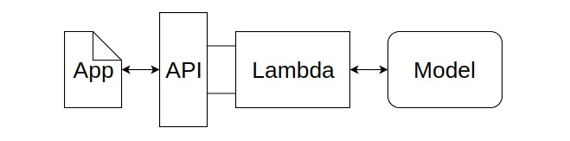
ICCCE-2021
System Architecture
In this proposed system, we are creating a RESTful API with a single endpoint that will be used to provide an image to the Image Captioning model running on the server. For creating an API, we will use AWS API Gateway Service and AWS Lambda. AWS Lambda will have a function to send the image received from the API request to the Image Captioning model on the AWS Sagemaker.
Operation Flow
5

Slide 6
ICCCE-2021
System Architecture
The starting point of this system will be an application that can run on any platform like a mobile phone, smartwatch, or any IoT devices. This application will send an image through the API request to the AWS Lambda function. The picture that is sent by the application will be a pre-captured image or an image captured by the camera device. The AWS Lambda function will be responsible for transferring this image for further processing to the Image Captioning model where the image is processed, and an appropriate caption describing that image will be generated. This caption will be in a text format. The API response will send this caption back to the application, and this caption will be spoken out loud by the device. Also, the caption will be displayed on the device screen, if that device has a screen.
6

Slide 7
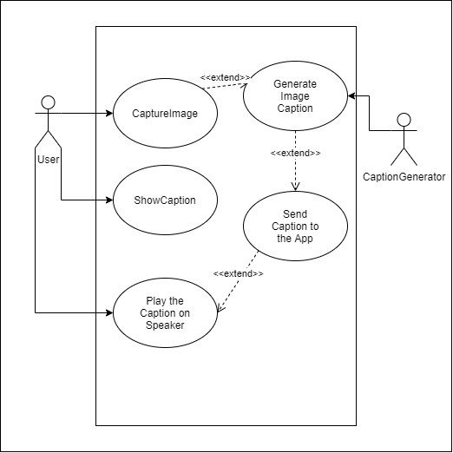
ICCCE-2021
Use case Diagram
7

Slide 8
ICCCE-2021
Results
For evaluating the performance of our methods, we are using the MS COCO[8], Flickr8K[9], and Flickr30K[10] datasets. They are the most popular and efficient datasets for measuring the accuracy of the generated information.
Table 1 shows the detailed comparisons of reference captions on the three datasets above. The MS COCO dataset is a large-scale object detection, segmentation, and captioning dataset. The official version of MS COCO dataset includes over 82000 training images, over 40000 validation images, and over 40000 test images. Since the “Karpathy'' split is the most commonly used split method for reporting results, we use it to split the official MS COCO dataset to obtain around 113,000 training images, 5000 validation images, and 5000 test images. The Flickr8K dataset comes with an officially split of 6000 images for training, 1000 images for validation images, and 1000 images for testing. Without any official split, the Flickr30K dataset has 31,783 images that we will split into 25,000 training images, 2000 validation images, and 3000 images for testing.
8

Slide 9
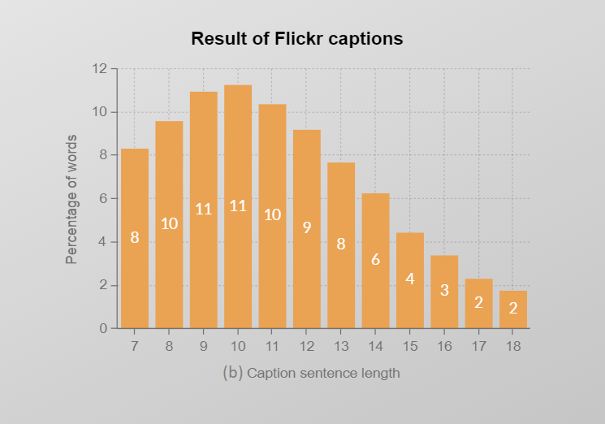
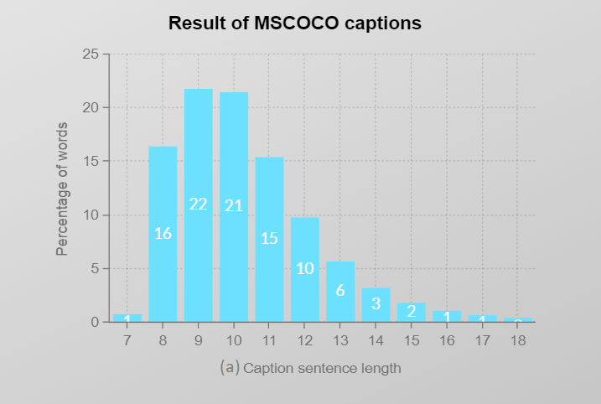
ICCCE-2021
Result of Flickr caption vs MSCOCO caption
Percentage of words per caption sentence length
(a) shows the statistical results of reference captions on MS COCO dataset; (b) shows the statistical results of reference captions on Flickr8K and Flickr30K datasets. The x-axis represents the length of each caption sentence.
9

Slide 10
ICCCE-2021
Evaluation Metrics
We test the effectiveness of our method with many well-known metrics using image captions, including CIDEr, CIDEr [11], SPICE [12], METEOR [13], ROUGE-L [14], and BLEU [15].
CIDEr and SPICE are both human consensus metrics. CIDEr can be used to measure the similarity between a generated caption and a set of definitions written by humans. In addition, SPICE is a conditional metric, which is used to test how well a structured sentence captures objects, attributes and relationships between them. METEOR calculates sentence level similarities according to the harmonic definition of uni-gram recall and precision. ROUGE-L can be used for gisting evaluation. Its scores are calculated by measuring the number of scattered units, such as n-gram, word order, and the alteration of words between generated captions and human writing sentences. BLEU is a metaphor that is widely used in machine translation operations. It is based solely on the cohesiveness of the n-grams.
10

Slide 11
ICCCE-2021
Conclusion
The results above show that the algorithm we had used fits accurately to our proposed system and gives better results than the previous methods used for image caption generation.
11

Slide 12
ICCCE-2021
References
Oriol Vinyals, Alexander Toshev, Samy Bengio, and Dumitru Erhan (2015) Show and tell: A neural image caption generator. CVPR 1, 2
K. Xu (2016) Show, attend and tell: Neural image caption generation with visual attention. inProc. Int. Conf. Mach. Learn.
Andrej Karpathy, Li Fei Fei (2015) Deep Visual-Semantic Alignments for Generating Image Descriptions. IEEE Transactions on Pattern Analysis and Machine Intelligence (April 2017), vol 39, issue 4:664–676.
Image Captioning with Keras teaching computers to describe pictures
Ayush Yadav, Rutgers The State University of New Jersey (2017) Camera2Caption: A real-time image caption generator.
Oriol Vinyals, Alexander Toshev, Samy Bengio, Dumitru Erhan (2016) Show and tell: Lessons learned from the 2015 MSCOCO image captioning challenge PAMI
Wei, Y.; Xia, W.; Huang, J.; Ni, B.; Dong, J.; Zhao, Y.; Yan, S. CNN: Single-label to Multi-label. arXiv 2014, arXiv:1406.5726.
Lin, T.; Maire, M.; Belongie, S.J.; Bourdev, L.D.; Girshick, R.B.; Hays, J.; Perona, P.; Ramanan, D.; Dollár, P.; Zitnick, C.L. Microsoft COCO: Common Objects in Context. arXiv 2014, arXiv:1405.0312.
12

Slide 13
ICCCE-2021
References
Hodosh, M.; Young, P.; Hockenmaier, J. Framing Image Description As a Ranking Task: Data, Models and Evaluation Metrics. J. Abbr. 2013, 47, 853–899.
Young, P.; Lai, A.; Hodosh, M.; Hockenmaier, J. From image descriptions to visual denotations: New similarity metrics for semantic inference over event descriptions. Trans. Assoc. Comput. Linguist. 2014, 2, 67–78.
Vedantam, R.; Zitnick, C.L.; Parikh, D. CIDEr: Consensus-based Image Description Evaluation. arXiv 2014, arXiv:1411.5726.
Anderson, P.; Fernando, B.; Johnson, M.; Gould, S. SPICE: Semantic Propositional Image Caption Evaluation. In ECCV; Springer: Cham, Switzerland, 2016; pp. 382–398.
13 Denkowski, M.; Lavie, A. Meteor Universal: Language Specific Translation Evaluation for Any Target Language. In Proceedings of the Ninth Workshop on Statistical Machine Translation, Association for Computational Linguistics, Baltimore, MD, USA, 26–27 June 2014; pp. 376–380.
Lin, C.Y. ROUGE: A Package for Automatic Evaluation of Summaries. In Proceedings of the ACL-04 Workshop Text Summarization Branches Out, Barcelona, Spain, 25–26 July 2004; pp. 74–81.
Papineni, K.; Roukos, S.; Ward, T. BLEU: A method for automatic evaluation of machine translation. In Proceedings of the 40th Annual Meeting on Association for Computational Linguistics, Philadelphia, PA, USA, 7–12 July 2002; pp. 311–318. 20. Farhadi, A.; Hejrati, M.; Sadeghi, M.A.
13

Slide 14

THANK YOU

